Slide 1

SHREE RAMSWAROOP MEMORIAL UNIVERSITY
Assignment:-14
Java Enterprise Edition Lab - 14
Submitted to:
Submitted by:
Vidushi Srivastava
Mukesh Prajapati
Btech (Cse Industry integrated)
Roll No – 202410101230007

Slide 2
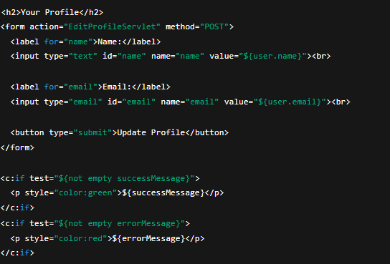
1. Create JSP for Profile Viewing
A JSP page (profile.jsp) displays the user’s profile information (name and email) using EL expressions.
Form fields are prefilled with the user’s data (${user.name}, ${user.email}).
On submission, data is sent via POST to EditProfileServlet.

Slide 3
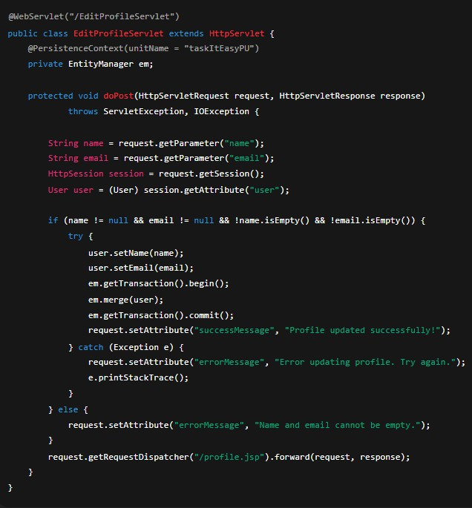
2. Create EditProfileServlet
This servlet handles form submission and updates the user data in the database using JPA.

Slide 4
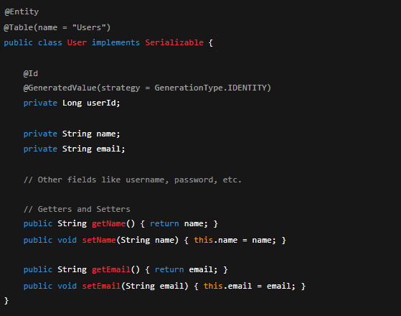
3. User Entity Class
Ensure proper mapping between the User class and Users table.
Display Messages in JSP
  c:if JSTL tags show feedback messages after the update operation.
  Green message for success, red for errors.
Testing and Validation
  Check if the user can update name and email successfully.
  Verify changes are reflected in the database.
  Ensure validation prevents empty fields.
  Confirm that error messages display correctly.

